Slide 1



Trusted Sources Training for
Kentucky Student Success Collaborative | The Hope Center for Student Basic Needs
Student Basic Needs
Notes:
Thank you everyone for joining us today for this Trusted Sources Training for Student Basic Needs. My name is/our names are: [insert name & title/role/affiliation of presenter(s)].
[Feel free to share a bit about how often you see basic needs issues arise on your campus/in your role and why you personally know and feel they are important to address promptly, effectively, and thoughtfully with resources.]

Slide 2



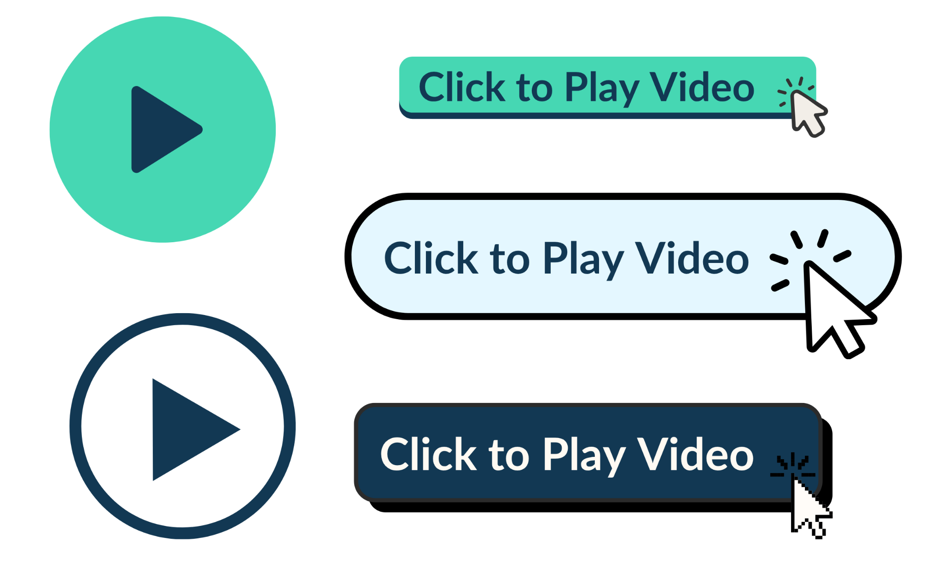
Welcome from
Dr. Aaron Thompson (VIDEO)
Notes:
To begin, we have a brief video from Dr. Aaron Thompson, President of the Kentucky Council on Postsecondary Education that outlines the origins of this work.

Slide 3


About this Training
In 2023, The Kentucky Council on Postsecondary Education (CPE) convened the Student Basic Needs Action Network to develop a statewide strategy to achieve two objectives:
Increase access to basic needs supports for postsecondary students, and
Increase access to postsecondary education for individuals receiving state supports.
Notes:
Use this slide only when unable to play the video on Slide 2; otherwise it can be hidden from the presentation
In 2023, The Kentucky Council on Postsecondary Education (CPE) convened the Student Basic Needs Action Network to develop a statewide strategy to achieve two objectives: 1) Increase access to basic needs supports for postsecondary students, and 2) Increase access to postsecondary education for individuals receiving state supports.

Slide 4

Ensuring that all students are able to meet their basic needs is part of the state’s strategy to increase educational attainment and economic mobility for low-income students so that:
60% of working-age adults hold a postsecondary degree or credential by 2030.
Notes:
Use this slide only when unable to play the video on Slide 2; otherwise it can be hidden from the presentation
Ensuring that all students are able to meet their basic needs while enrolled is a cornerstone of the state’s broader strategy to increase educational attainment and economic mobility for low-income students in pursuit of ensuring that 60% of working-age adults hold a postsecondary degree or credential by 2030.

Slide 5
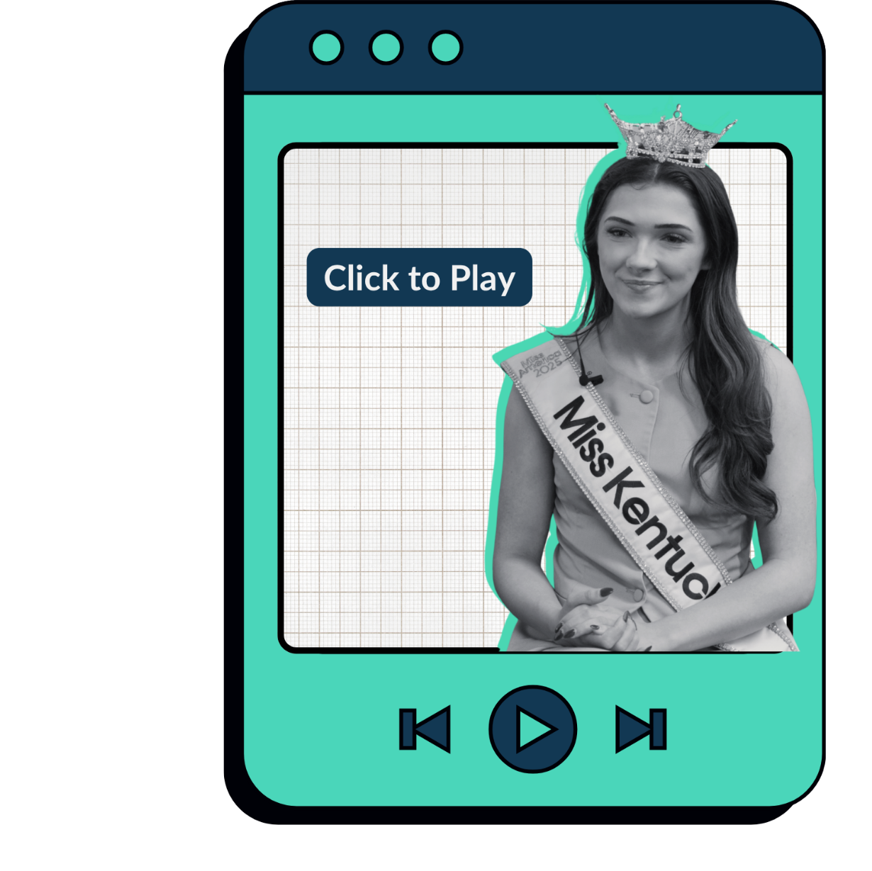


Your Role
and Opportunity
Notes:
At its core, basic needs work is about supporting students. As Ariana Rodriguez, the current Miss Kentucky and a former foster youth, shares, each of you has a vital role to play in ensuring that this work is successful in reaching every student.

Slide 6

Training Goals
Recognize how you can help cultivate a culture where student success is everyone’s role.​
Understand how to respond to a student experiencing basic needs insecurity and connect them with existing campus and community resources.
Equip all campus employees with the information, skills, and confidence to effectively support student basic needs.
Notes:
Our goals for today's training are for you to be able to:
Recognize how you can help cultivate a culture where student success is everyone’s role.​
Understand how to respond to a student experiencing basic needs insecurity and connect them with existing campus and community resources.
Equip all campus employees with the information, skills, and confidence to effectively support student basic needs.

Slide 7
01
What are
Student Basic Needs?
Notes:
We recognize that, depending on your role, many of you may have varying levels of familiarity with the concept of student basic needs, so we'd like to begin by providing an overview of the topic so that we can all work from the same foundation as we move through today's training.

Slide 8

Notes:
To start, we'd like to share a small portion of this video from The Hope Center for Student Basic Needs, and we encourage you to check out the full thing on their website. [Play video]

Slide 9





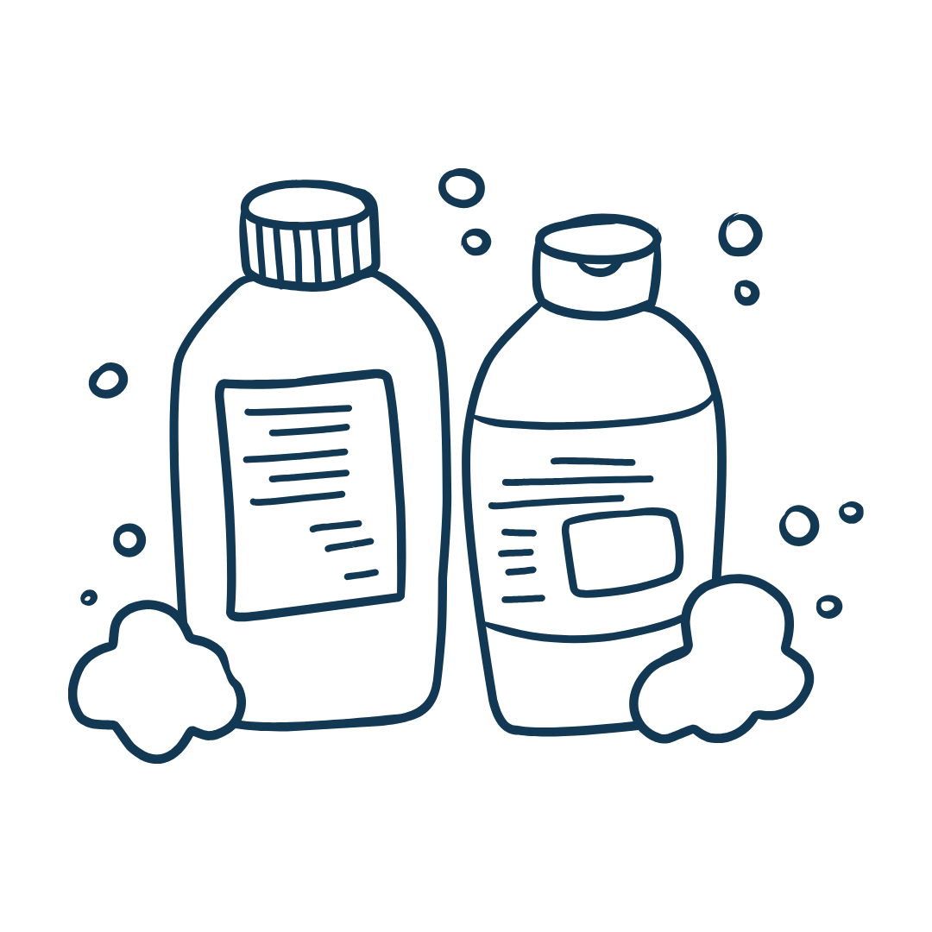

Basic Needs
Regular, nutritious, safe, and sufficient food​ and water
Safe and secure housing—to sleep, study, cook, and shower​
Regular, nutritious, safe, and sufficient food​ and water
Healthcare for sustained mental and physical health
Affordable technology and internet service
Reliable and accessible transportation
Resources for personal hygiene​
Childcare and related dependent care needs
Notes:
As Mark indicated, basic needs are often overlapping and intersectional, so it’s important to provide resources and support that address an expansive array of needs, including:
Regular, nutritious, safe, and sufficient food​ and water
Safe and secure housing—to sleep, study, cook, and shower​
Health care for sustained mental and physical health
Affordable technology and internet service
Reliable and accessible transportation
Resources for personal hygiene​
Child care and related dependent care needs

Slide 10




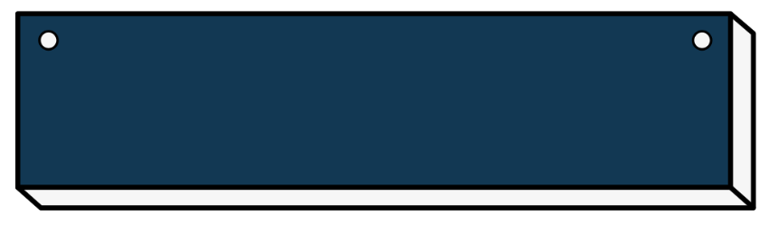
Many of us are balancing school with parenting, bills, and real-life struggles. We aren’t just students—we’re caregivers, workers, and people trying to survive while improving our future.
Erica Wilburn
Gateway Community & Technical College
Notes:
Remember as well that basic needs insecurity is not the result of individual choices, but rather stems from the disconnect between our current systems and the needs of today’s students.
As Erica, a student from Gateway Community & Technical College student indicates, “Many of us are balancing school with parenting, bills, and real-life struggles. We aren’t just students—we’re caregivers, workers, and people trying to survive while improving our future.”

Slide 11

02
Student Basic Needs Insecurity
Prevalence
and Impacts
Notes:
Beyond understanding what basic needs insecurity is, it's also important to recognize that it is far too common among today’s college students.

Slide 12


National
Statistics
1 in 4 undergraduate students experience food insecurity.
4.3 million
students
Undergraduate students experienced food insecurity at twice the rate of all U.S. households.
aren’t getting enough to eat.
1.5 million
students
are homeless.
Source: National Postsecondary Student Aid Survey
Notes:
Data from the National Postsecondary Student Aid Survey indicates that nearly 1 in 4 undergraduate students experience food insecurity.
This means that roughly 4.3 million students aren’t getting enough to eat. It also means that undergraduate students experience food insecurity at twice the rate of all U.S. households.
At the same time, 1.5 million students are experiencing homelessness.

Slide 13



Source: 2023 Trellis Student Financial Wellness Survey
Kentucky
Statistics
According to a 2023 survey of over 2800 Kentucky students from Kentucky’s Community and Technical College System:
46%
of students
of students experienced low or very low food security.
55%
of students
59%
of students
of students reported experiencing housing insecurity.
experience some form of basic needs insecurity.
Notes:
In Kentucky, data from Trellis’ 2023 Student Financial Wellness Survey representing over 2800 students from 16 Kentucky colleges show that:
59% of students face one or more forms of food insecurity, housing insecurity, or homelessness.
46% of students experienced low or very low food security.
55% of students reported experiencing housing insecurity.
15% of students reported experiencing homelessness.

Slide 14

Key Populations for Outreach
of Pell-Grant or other grant recipient students experience basic needs insecurity.
65%
of first-generation students experience basic needs insecurity.
66%
of Adult (25+) students experienced basic needs insecurity.
67%
of parenting students experienced basic needs insecurity.
68%
Source: 2023 Trellis Student Financial Wellness Survey
Notes:
As basic needs insecurity often stems from a confluence of systemic factors outside any one individual's control, it is simultaneously true that ANY student can experience basic needs insecurity AND that some student populations also experience basic needs insecurity at higher rates than their peers. Trellis’ survey of Kentucky students found, for example that:
65% of Pell-Grant or other grant recipient students experienced basic needs insecurity.
66% of First-Generation students experienced basic needs insecurity.
67% of Adult (25+) students experienced basic needs insecurity.
68% of Parenting students experienced basic needs insecurity.

Slide 15

Impacts & Consequences
Students experiencing one or more forms of basic needs security
report significantly lower GPAs than their peers.
Food and housing insecurity are associated with
a lower likelihood of degree attainment and worse mental health.
Untreated mental health disorders are associated with
lower GPAs, enrollment discontinuity, and dropout.
Source: tinyurl.com/kysscsources
Notes:
Is it mission creep? NO. To invest in basic needs is NOT to turn into a social service agency.
When those supports aren't in place, the primary impact is a human one – students suffer.
And this leads, of course, to an academic impact, including lower GPAs and decreased likelihood of degree attainment that directly undermine the success of the institution’s core academic mission.
Research consistently shows that:
Students experiencing one or more forms of basic needs security report significantly lower GPAs than their peers.
Food and housing insecurity are associated with a lower likelihood of degree attainment and worse mental health (e.g., depression and anxiety).
Untreated mental health disorders are associated with lower GPAs, enrollment discontinuity, and dropout.

Slide 16



For students with families like me with three children, basic needs and academic success are inseparable. When a student is hungry or facing eviction, they cannot perform to their highest potential. Supporting these needs is not just an act of aid; it is a fundamental requirement for academic excellence.”
Graduate Student
University of Kentucky
Notes:
As one graduate student from the University of Kentucky shares, “For students with families like me with three children, basic needs and academic success are inseparable. When a student is hungry or facing eviction, they cannot perform to their highest potential. Supporting these needs is not just an act of aid; it is a fundamental requirement for academic excellence.”

Slide 17

Major Gaps in Accessing Supports
Reasons why students experiencing BNI did not use campus supports:
Source: The Hope Center 2023-24 Basic Needs Survey
Notes:
Recognizing these impacts, many of your campuses have already established resources to support students’ basic needs.
Unfortunately, research and feedback from students suggest that even when services and benefits are available, students often aren't receiving them.

Slide 18
26%
74%
8%
Concerns about scarcity (taking resources that others need more).
Lack of awareness (of available resources, eligibility for
resources, or how to access resources).
Social stigma (fear of being mistreated, how others
might view them).
25%
Availability (having other obligations; lack of time).
Notes:
Frequently, the assumption is that this is related to stigma. However, in a survey by The Hope Center survey of over 74,000 students from 91 colleges and universities throughout the country, only 8% of students indicated they didn’t access resources due to stigma. On the other hand, 74% of students told us that not knowing about available resources, their eligibility rules, or how to access them were barriers that got in the way.

Slide 19


2/3 of students
who are likely eligible for SNAP are not receiving benefits
Source: U.S. Government Accountability Office, 2024.
Notes:
Federal data indicate that students are similarly struggling to access federal resources for meeting basic needs. For example, a 2024 report from the Government Accountability Office found that 2/3rds of students who are likely eligible for SNAP—2.2 million students—are not receiving benefits.

Slide 20
03
Student Basic Needs Insecurity
Talking with Students
Notes:
So, what can we do about the high prevalence of basic needs insecurity on our campuses and the gaps in getting students the supports they need and deserve? What role do you play? [give a pause for reflection]
In the work that led to this training, Kentucky students shared that they often seek help when they are already in crisis and that they do so by reaching out to individuals they already know and trust. That is, many of you. As such, you play a vital role in helping to bridge the awareness and information gap by ensuring that, when students do turn to you, they are connected with the full range of resources your institution has to offer.

Slide 21


Recognizing Signs of Basic Needs Insecurity
Faculty and staff are often frontline observers of student struggles. Recognizing the signs allows for early, compassionate intervention.
Notes:
Faculty and staff are often frontline observers of student struggles. Recognizing the signs allows for early, compassionate intervention, helping students to access resources BEFORE they reach a crisis point.

Slide 22



In the Classroom
Decline in academic performance
Requests
for accommodations
Increased absences
Notes:
In the Classroom
Decline in academic performance: A student's work quality or attendance suddenly drops, or they struggle to concentrate.
Requests for accommodations: Repeatedly asking for deadline extensions or showing extreme anxiety about exams.
Increased absences.

Slide 23



Behavioral Changes
Increased stress, anxiety, irritability, or unusual emotional outbursts.
Excessive fatigue
Social withdrawal
Notes:
Behavioral Changes
Increased stress, anxiety, irritability, or unusual emotional outbursts.
Excessive fatigue: Falling asleep in class or constantly appearing tired.
Social withdrawal: A previously engaged student stops participating in class or group activities.

Slide 24

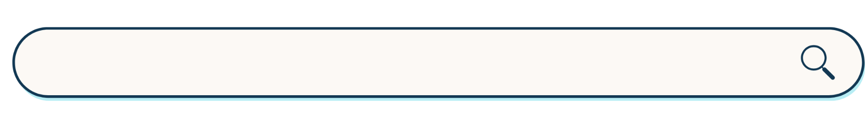
Additional Observations
Students may also…
Express stress about everyday expenses
Exhibit changes in appearance
Consistently or suddenly lack course materials
Mention concerns about their ability to balance coursework with caregiving responsibilities
Notes:
Students may also express stress about paying for things like housing or groceries, exhibit changes in appearance such as decreased hygiene or weight loss, have a consistent or sudden lack of course materials, and/or mention concerns about their ability to balance coursework with caregiving responsibilities.

Slide 25
Talking with Students about Their Needs
The goal is to respond with empathy and connect the student to specialized resources, not to solve their problems yourself.
Prepare your approach
Listen and acknowledge
Collaborate on solutions
Notes:
If you’ve identified that a student may be struggling to meet their basic needs—or if a student has broached the subject with you--the goal is to respond with empathy and connect the student to specialized resources, not to solve their problems yourself.
Prepare your approach: Find a private, quiet setting to speak with the student. Start by expressing your genuine concern and compassion. You can begin by mentioning your specific observations, such as, "I've noticed you seem more stressed lately" or "I'm concerned about your recent absences from class.”
Listen and acknowledge: Let the student share what they're comfortable with. Listen attentively without judgment and validate their experience. Phrases like, "It sounds like you're going through a lot right now," can build trust and show you respect their feelings.
Collaborate on solutions: Use open-ended questions to discuss what strategies and resources the student already uses to meet their needs—and what has been unhelpful—to help identify next steps. Consider questions like, “What kind of supports have you used that have been helpful to you?” and “What challenges or barriers have you experienced when asking for help?”

Slide 26

My professors will email me every couple weeks, and tell me I’m doing a great job, and that makes me feel seen.
Angel Moller
Gateway Community & Technical College
Notes:
Such conversations may feel daunting at first, so it's okay to ease into the habit with short messages of support. As Angel shares, “My professors will email me every couple weeks, and tell me I’m doing a great job, and that makes me feel seen.”

Slide 27
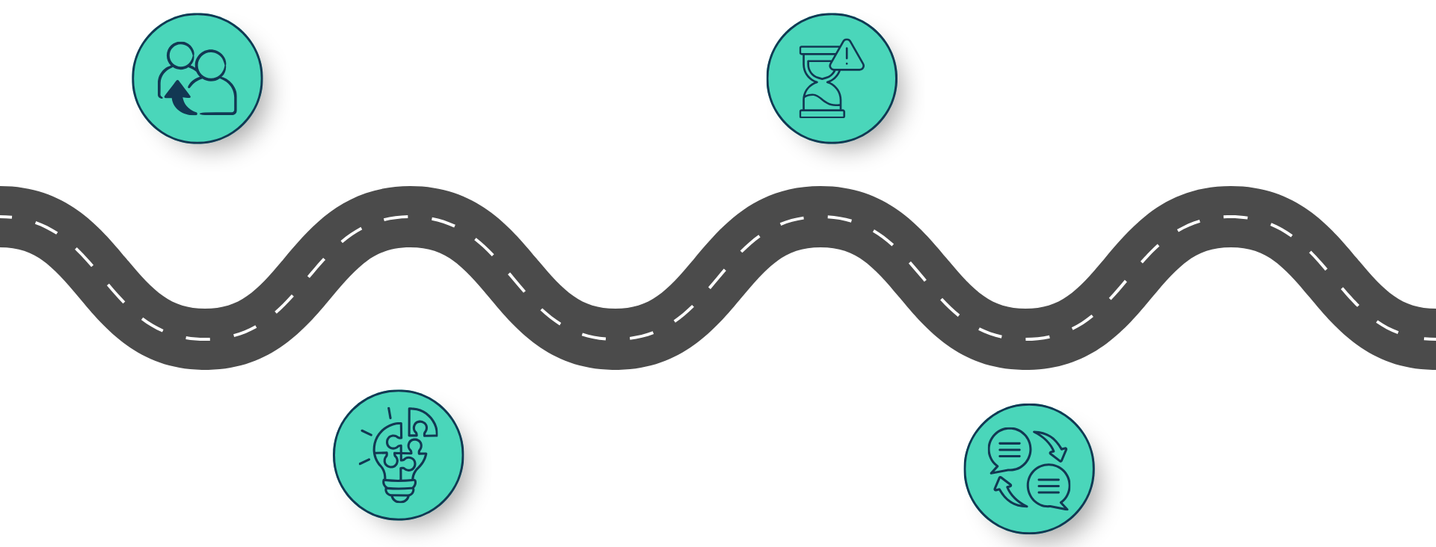
Connecting Students with Resources
Provide a warm referral
v
And your limits
v
Know your resources…
v
Don’t forget to follow up
v
Notes:
Turning the conversation to available resources, the best approach is to provide a warm referral or handoff.
Provide a warm referral: Instead of simply listing resources, actively help them take the next step.
Don't say: "You should check out the food pantry.“
Do say: "I can connect you with our basic needs center, and someone there can walk you through the process for getting food and other support. I've found it to be a helpful and confidential service for many students.“
If possible, taking the student to the resource location or relevant staff member directly is a great way to help the student feel comfortable meeting someone new in an unfamiliar space.
Know your resources: Familiarize yourself with campus offices and keep a list of key contacts.
And your limits: You are not expected to be a crisis counselor. Be honest about what you can and cannot do.
Follow up: If appropriate, check in with the student after they have had time to access the resources. A brief email saying, "Just checking in to see how you're doing," shows you care and reinforces that they are not alone.

Slide 28
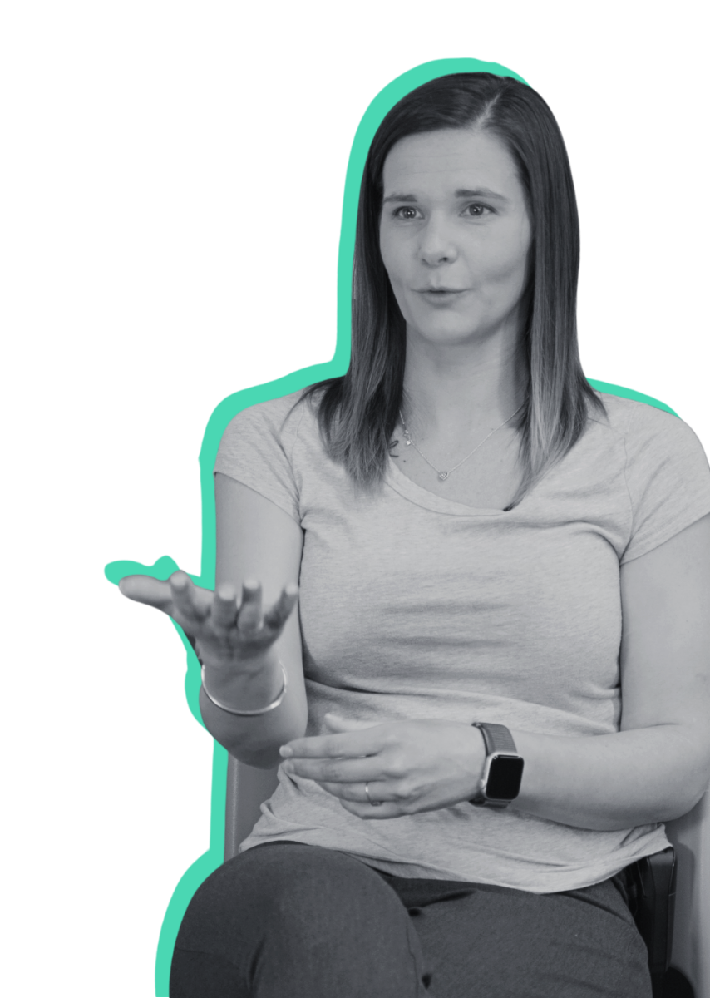
Professors and faculty want to help but they don’t know how. Even a professor saying ‘Hey, I don’t know what you need but how can I help?’ goes such a long way. That means the world.
Maren Snider
Northern Kentucky University
Notes:
Again, the impact of even a brief interaction or message cannot be overstated. As Maren, a Northern Kentucky University student shares, “Professors and faculty want to help but they don’t know how. Even a professor saying "Hey, I don't know what you need but how can I help?” goes such a long way. That means the world.”

Slide 29

Practice Scenarios
Scenario #1
You notice a student has been consistently arriving late to class and his test scores have been dropping throughout the semester despite starting out very strong. He visits you in office hours but sits mostly quietly in the room. How would you respond?
During a meeting with you, a student mentions having to move between a few different friends’ houses lately and starts tearing up. They mention feeling hopeless and not sure what the point of asking for help would be. How would you respond?
Notes:
That's a lot of information to absorb at once, so we’re going to take a few minutes to walk through what talking to students can look like in practice by completing a pair of practice scenarios.
[Instructions for the practice scenarios can vary based on the modality of presentation. For example, for a live session, either in person or virtually, you could invite participants to roleplay, have small groups discuss their responses, or call on participants to respond. For a recorded session, you could offer time for reflection as in the recorded version of this training or provide a list of potential responses for participants to select from that could double as a knowledge check similar to those found in compliance trainings.]
Scenario #1: You notice a student has been consistently arriving late to class and his test scores have been dropping throughout the semester despite starting out very strong. He visits you in office hours but sits mostly quietly in the room. How would you respond?

Slide 30

Considerations for Your Response
Scenario #1
Approach the conversation with concern and compassion for their well-being and not just their academic performance.
Think about how you might prompt the student to open up without coming off as overly invasive.
You notice a student has been consistently arriving late to class and his test scores have been dropping throughout the semester despite starting out very strong. He visits you in office hours but sits mostly quietly in the room. How would you respond?
Notes:
Use this slide when the training is being delivered asynchronously; otherwise hide it and use the discussion methods indicated in the notes for Slide 29

Slide 31

Practice Scenarios
Scenario #2
During a meeting with you, a student mentions having to move between a few different friends’ houses lately and starts tearing up. They mention feeling hopeless and not sure what the point of asking for help would be. How would you respond?
Notes:
Scenario #2: During a meeting with you, a student mentions having to move between a few different friends’ houses lately and starts tearing up. They mention feeling hopeless and not sure what the point of asking for help would be. How would you respond?

Slide 32
Considerations for Your Response
Scenario #2
Make sure to validate the student’s experience instead of jumping straight to problem-solving.
Think about what you can do to provide support in the moment and who you can connect them with to offer more long-term assistance.
During a meeting with you, a student mentions having to move between a few different friends’ houses lately and starts tearing up. They mention feeling hopeless and not sure what the point of asking for help would be. How would you respond?
Notes:
Use this slide when the training is being delivered asynchronously; otherwise hide it and use the discussion methods indicated in the notes for Slide 29

Slide 33
04
Student Basic Needs Insecurity
Tools for Connecting
Students to Resources
Notes:
To be effective in connecting students to available resources, it is, of course, essential, that you know what those resources are and where to find them. That said, no one is expecting you to become an overnight expert on your institution’s basic needs resources.

Slide 34
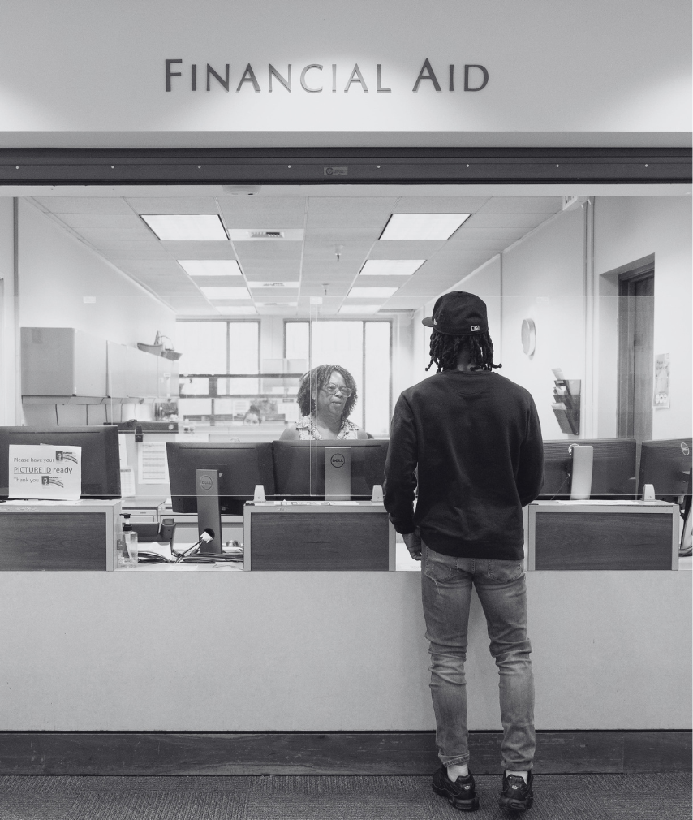
Photo by Allison Shelley/Complete College Photo Library
https://kystudentsuccess.org/basicneeds/
Basic Needs staff
Awareness-
building tools
Notes:
In fact, one of our final goals today is to highlight new & existing tools intended to help you identify, share, and connect students with the resources best suited to address their needs.
The Kentucky Student Success Collaborative’s centralized resource page is the best starting point to locate information about available campus and community basic needs resources.
Campus Basic Needs Staff can provide even more individualized support in helping students navigate and obtain support from available resources.
We’ve also created several awareness-building tools designed to help you spread the word about available resources to students AND to act as quick references you can turn to for key information.
Leveraging each of these tools in concert with one another will help to further cultivate a comprehensive, connected support ecosystem that reaches all students at your institution.

Slide 35
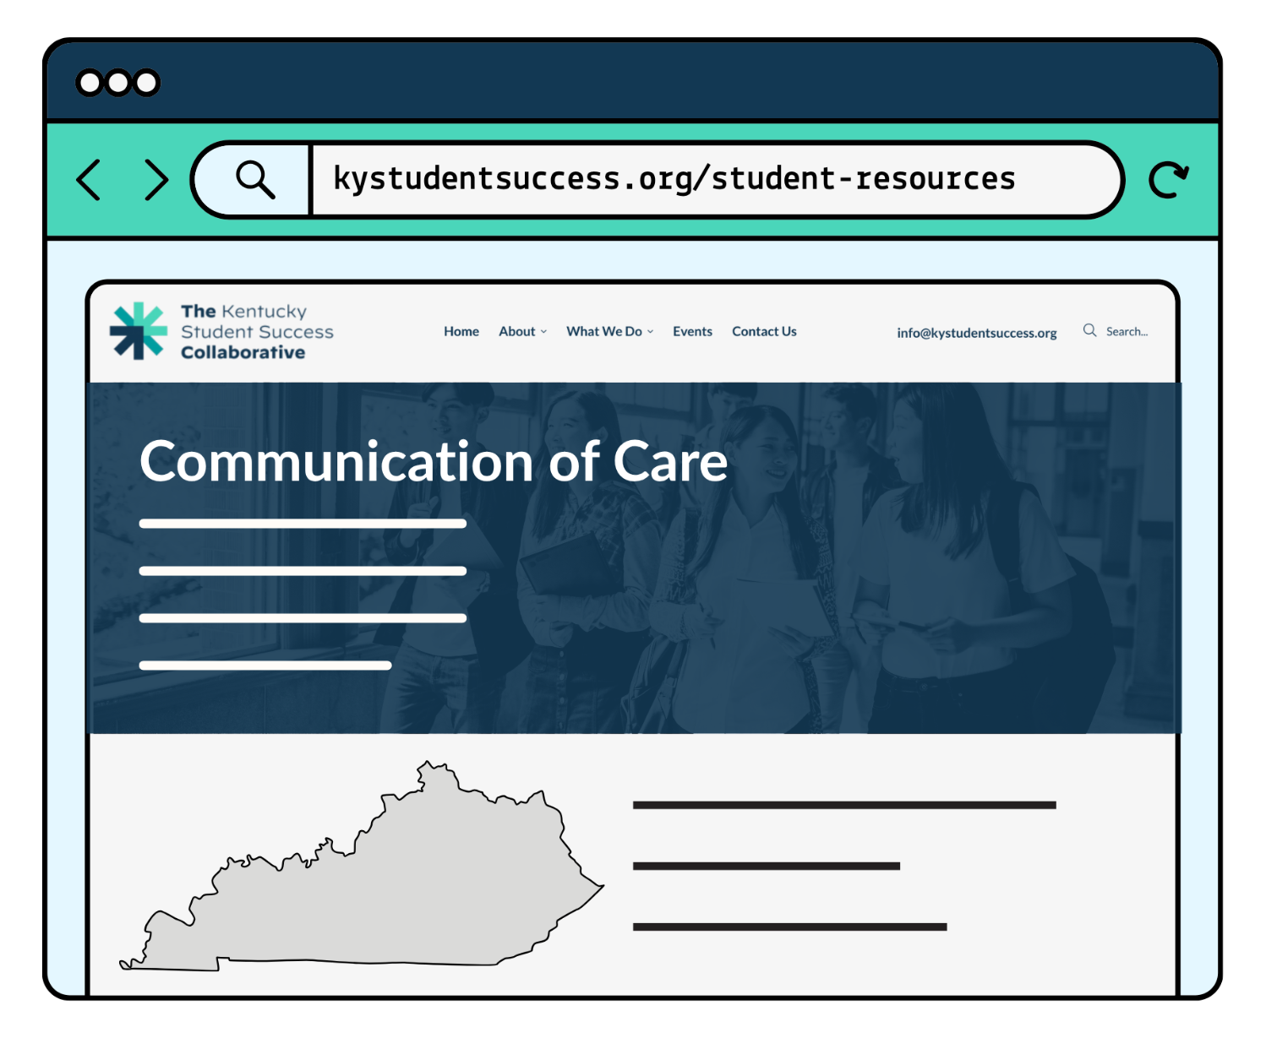
KYSSC Webpage
https://kystudentsuccess.org/basicneeds/​
A centralized place for information about:​
  Student experiences with basic needs insecurity​
  Campus and community resources​
  Contact info for basic needs staff
Notes:
The first of these resources is a new page on the Kentucky Student Success Collaborative website. This page is designed as a centralized location for students, faculty, and staff to locate information about student experiences with basic needs insecurity, campus and community resources that are available, and campus basic needs staff who can help find students the right support for their situation.

Slide 36



Beacon Chatbot
Click to Play: Beacon Walk-Through by Family Scholar House
Beacon, an interactive messaging tool, can help identify local resources and student supports.
Notes:
This new webpage uses an AI tool called Beacon to provide users with a regularly updated database of available campus and community resources. Our friend Sarah Brady from Kentucky Scholar House will now provide a brief overview of how Beacon works.

Slide 37
Basic Needs Staff
Your ‘go-to’ partner for connecting students with the full ecosystem of campus and community support.
Can keep you informed about new resources and changes to existing resources.
You can find your institution's basic needs staff contact at https://kystudentsuccess.org/basicneeds/ or on your campus’s basic needs webpage.
Notes:
Most, if not all Kentucky campuses also have a staff member acting as a main basic needs resource contact. You can think of them as your ‘go-to’ partner for connecting students with the full ecosystem of campus and community support.
In addition to addressing students’ immediate needs, cultivating a good relationship with your campus’s basic needs staff contact can help keep you informed about new resources and changes to existing resources that will further enhance your ability to effectively and proactively support students.
You can find your institution's basic needs staff contact on the KYSSC resource page or on your campus’s basic needs webpage.

Slide 38
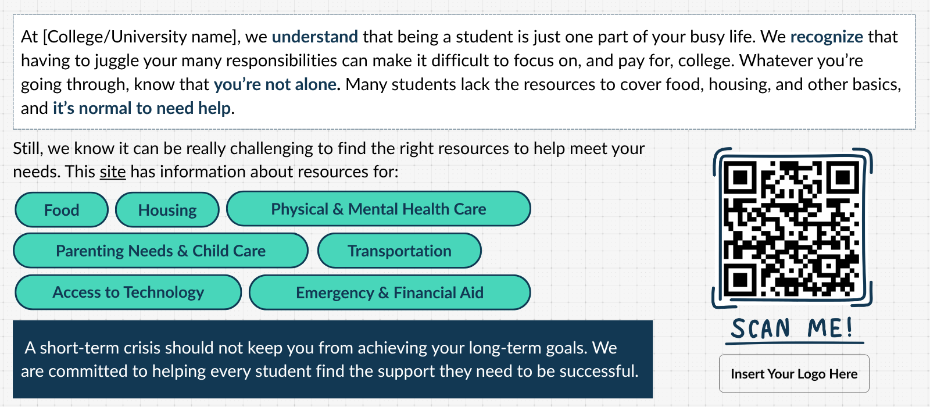
Resource Slide Template
Notes:
We also have tools to help you spread the word. We’ve created a PowerPoint slide template you can insert into presentations. Presentations such as those that faculty give during the first day of class or that student organizations provide during their inaugural meeting for the term. The QR code links students to the central website for basic needs resources that we described.

Slide 39
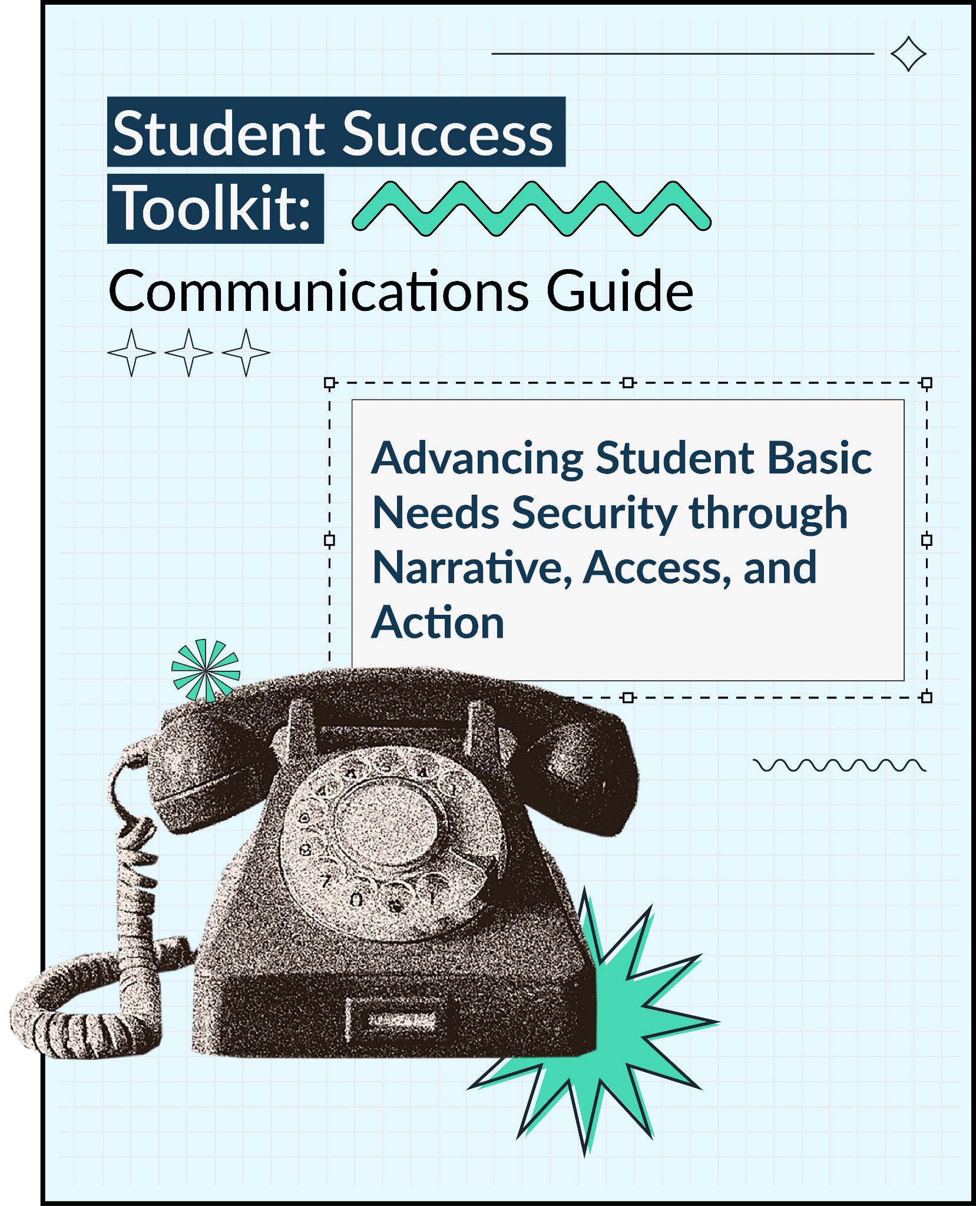

Comms Toolkit
Notes:
This template is included in the Communications Toolkit we’ve created alongside a host of other practical communications tools that you can adapt to fit your needs, including student stories, templates & resources, and design guidance. The toolkit is intended to help you more effectively connect students to the basic needs supports that already exist on your campus by supporting your ability to:
Increase awareness of basic needs resources across your campus ecosystem
Normalize help-seeking behavior and reduce stigma
Embed information seamlessly throughout the student experience
Strengthen trust between students and institutions
Support student retention and completion by improving access to critical resources

Slide 40

Syllabus Statement
The following are examples of effective, care-centered syllabus statements from Henderson Community College and Bellarmine University:
Notes:
Finally, the following slides offer a pair of syllabus statements that faculty can use to highlight campus services and plant the seed for future conversations with students.

Slide 41

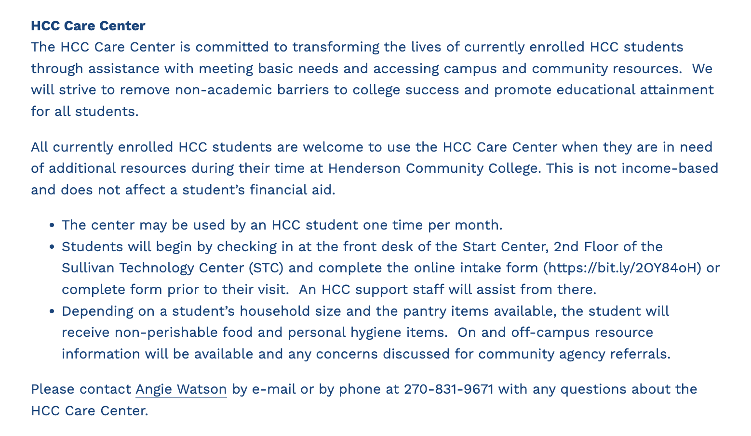
Notes:
The statement from Henderson Community College is located with other syllabus statements on their website, making it easy for faculty to simply copy-paste into their syllabi.

Slide 42
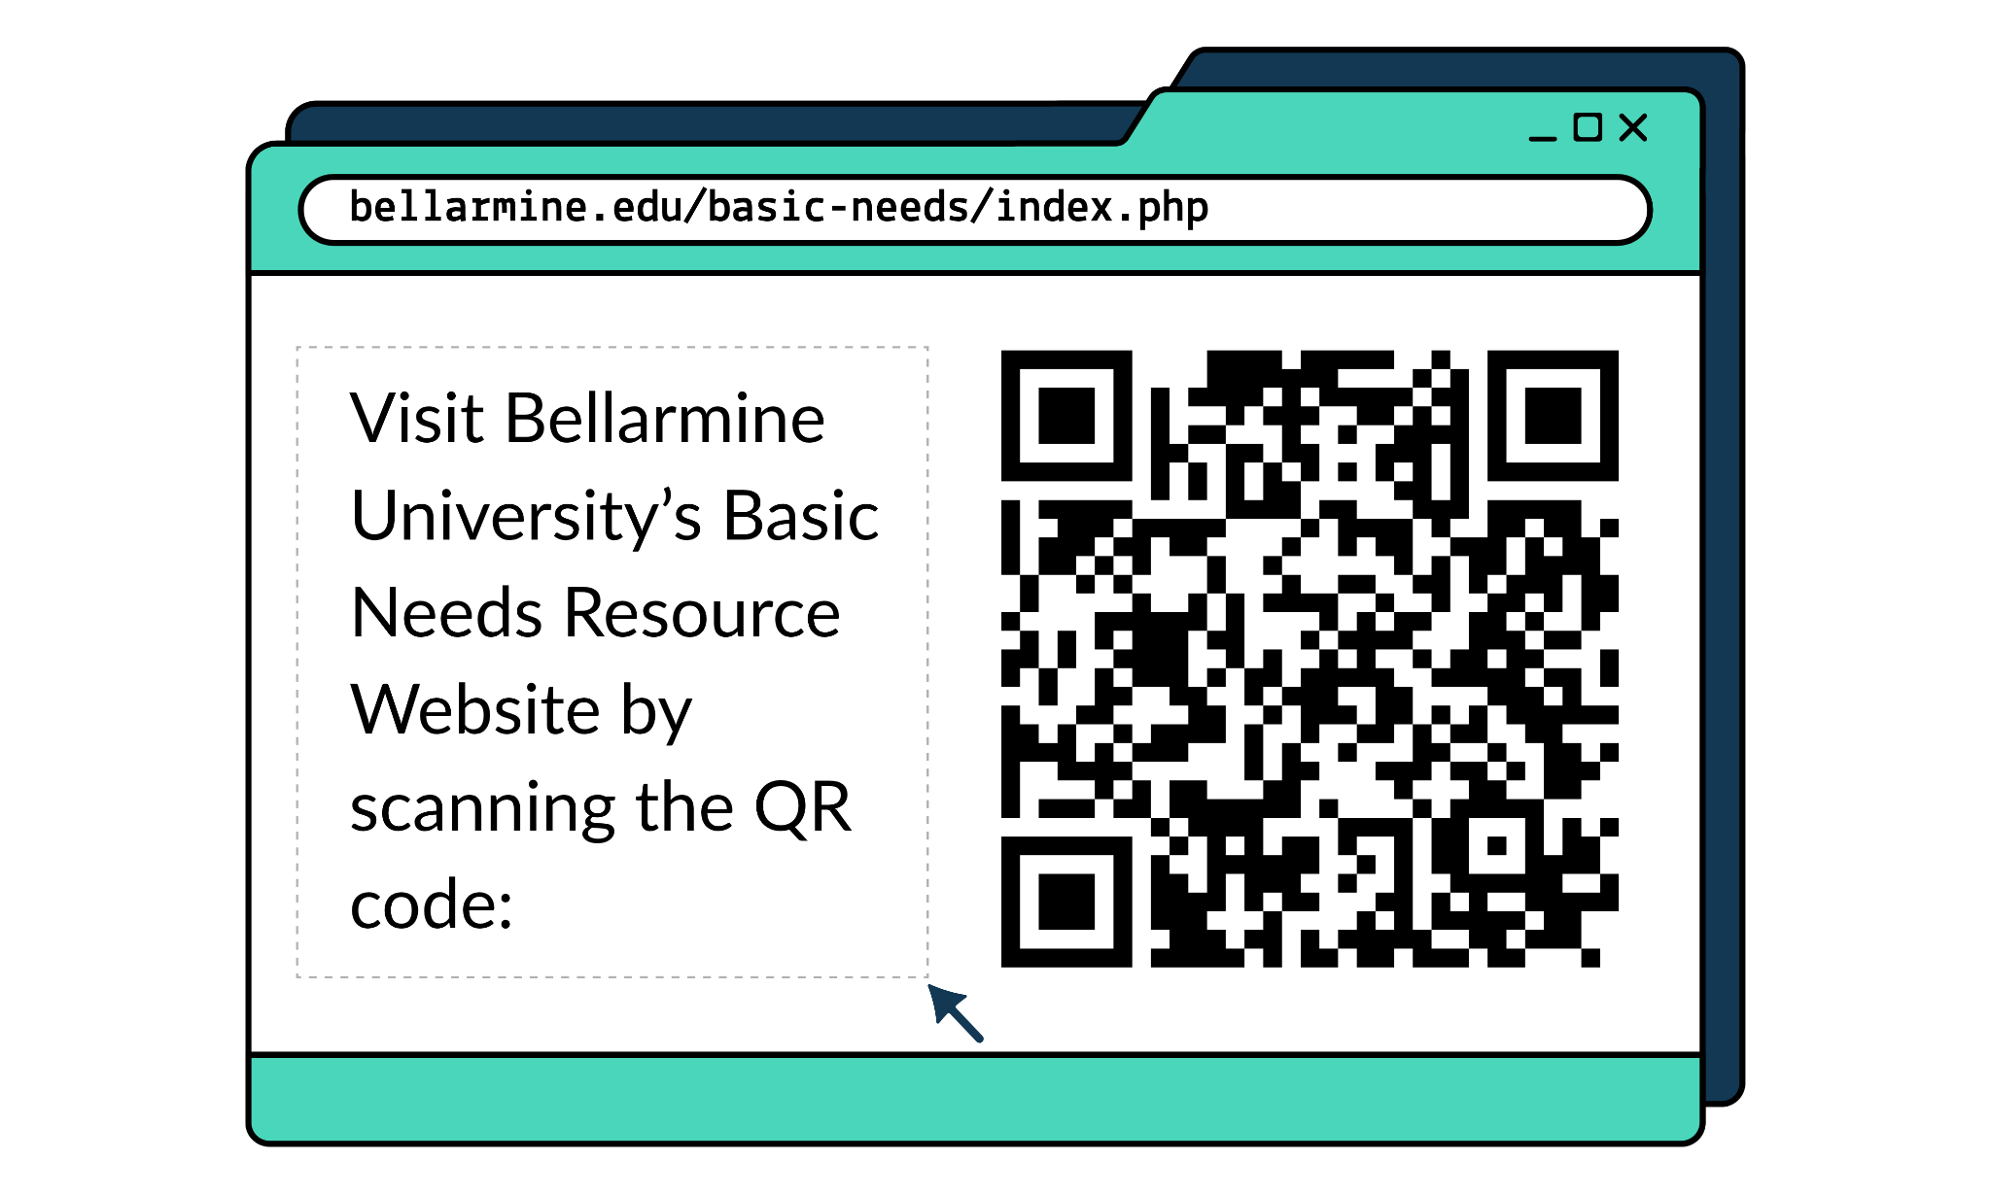
Notes:
For our second example, Bellarmine University has created a QR code that links to resource information, helping to limit the ever-growing sprawl of syllabus text.
Because students are often laser-focused on reviewing the assignments and grading criteria portions of their syllabi, we encourage faculty to directly call out the basic needs statement as part of their syllabus overview to ensure that it’s heard by students.
It can also be useful to remind students of the availability of resources or of the syllabus statement at the start or end of classes every few weeks to further normalize talking about basic needs insecurity and asking for help.

Slide 43
06
Key
Takeaways
Notes:
As we come to the end of our time together, we wanted to share some of the key lessons that we hope you carry forward into your day-to-day work engaging with students.

Slide 44

Everyone has a role to play in cultivating a culture of student success.
Integrate outreach about available basic needs resources into everyday conversations with students. This destigmatizes asking for help and fosters greater student awareness of and access to available resources.
Leverage https://kystudentsuccess.org/basicneeds/ and your campus basic needs staff to ensure students are being connected to all of the resources that best meet their needs.
Notes:
Everyone has a role to play in cultivating a culture of student success.
Integrate outreach about available basic needs resources into everyday conversations with students. This destigmatizes asking for help and fosters greater student awareness of and access to available resources.
Leverage the KYSSC resource page and your campus’s basic needs staff to ensure students are being connected to all of the resources that best meet their needs.

Slide 45
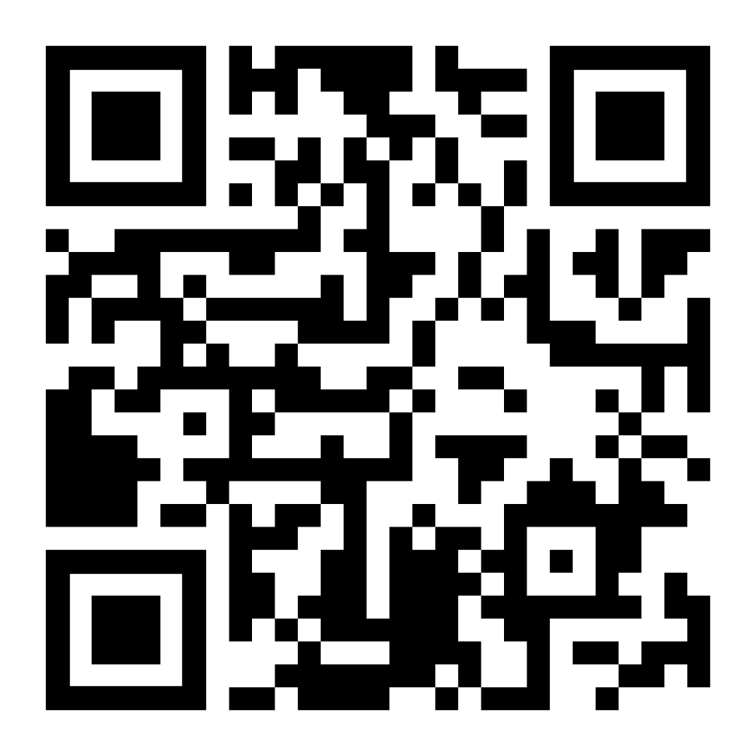
Session Completion Form
Notes:
Before we wrap up today, please take a moment to complete this brief form. This will help us know who has completed the training and the information that resonated with you the most. [Pause for a moment to let people pull up the form]
Link to the form: https://forms.gle/pzEJrUCqbLZJciaL9

Slide 46


Notes:
And finally, some closing words from Dr. Thompson and Ariana Rodriguez.

Slide 47





About
The Hope Center​
hope.temple.edu
We are researchers, scholars, advocates, conveners, and storytellers who envision a world where basic needs insecurity is no longer a barrier to pursuing and completing college. ​
Notes:
We would like to thank The Hope Center for their partnership in creating this Trusted Sources Training for Student Basic Needs.
The Hope Center for Student Basic Needs is a team of researchers, scholars, advocates, conveners, and storytellers who envision a world where basic needs insecurity is no longer a barrier to pursuing and completing college.

Slide 48




Research
investigating students' lived experiences with basic needs insecurity and evaluating interventions ​
Policy
Practice
informing and advocating for systemic policy change to make college affordable​
technical assistance to meet student basic needs through systems transformation ​
Notes:
The Hope Center team is constructed of three collaborative pillars that weave together research, policy, and practice.

Slide 49

Partnerships Informing Our Work​
Through our Hope Impact Partnerships (HIP) program, we have worked with over 240 colleges throughout the country. ​
We support institutions & state systems to use data to build awareness of student needs and connect more students to resources.
Notes:
Through their Hope Impact Partnerships (HIP) program, they have worked with over 240 colleges throughout the country. ​
They support institutions & state systems to use data to build awareness of student needs and connect more students to resources.

Slide 50



Acknowledgements
As part of Kentucky’s broader strategy to improve postsecondary attainment and economic mobility for students from low-income backgrounds, The Hope Center for Student Basic Needs partnered with the Kentucky Council on Postsecondary Education and the Kentucky Student Success Collaborative to support how colleges and universities communicate about basic needs and connect students to available resources. Made possible through support from ECMC Foundation, this work advances Kentucky’s efforts to help more students meet their everyday needs while pursuing their educational goals and contributes to the state’s goal of ensuring that 60% of working-age adults hold a postsecondary degree or credential by 2030.

