Slide 1
College admission page

Slide 2
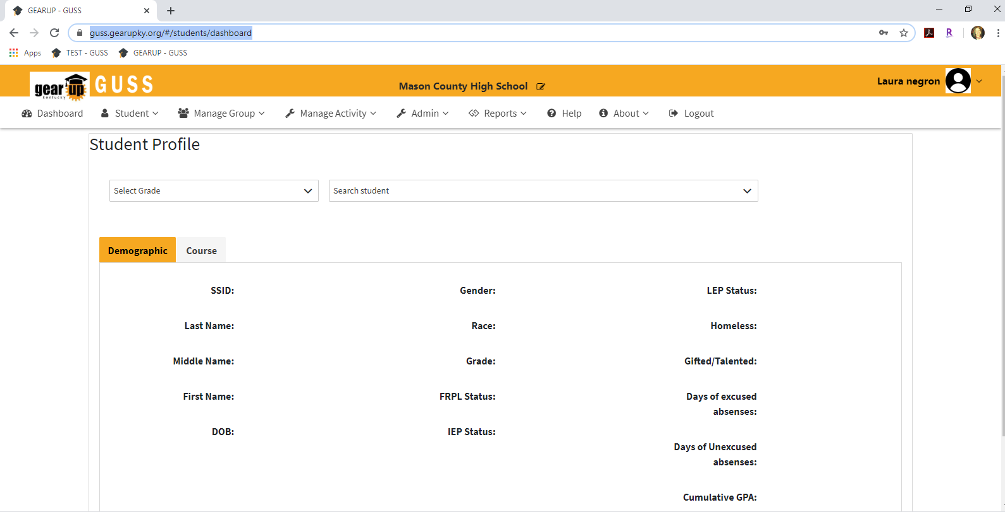
GUSS NEW FEATURE TRAINING – COLLEGE ADMISSION PAGE
1. Log into GUSS and Select the Student tab.

Slide 3
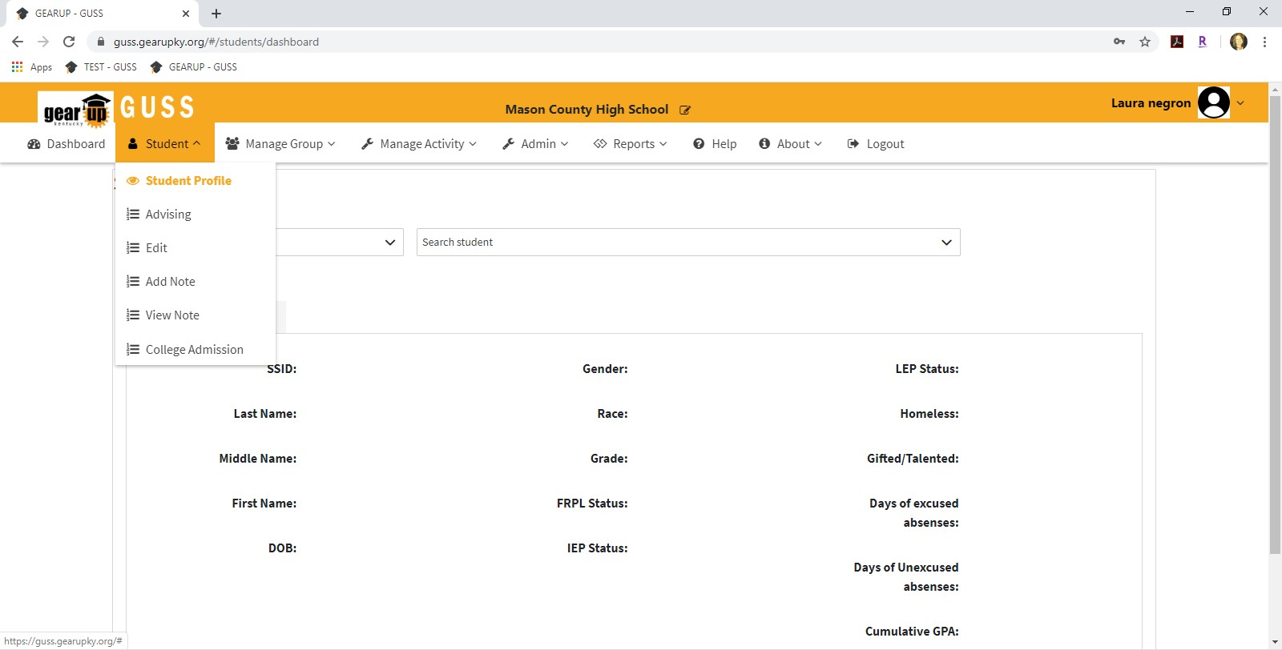
GUSS NEW FEATURE TRAINING – COLLEGE ADMISSION PAGE
2. Select College Admission.

Slide 4
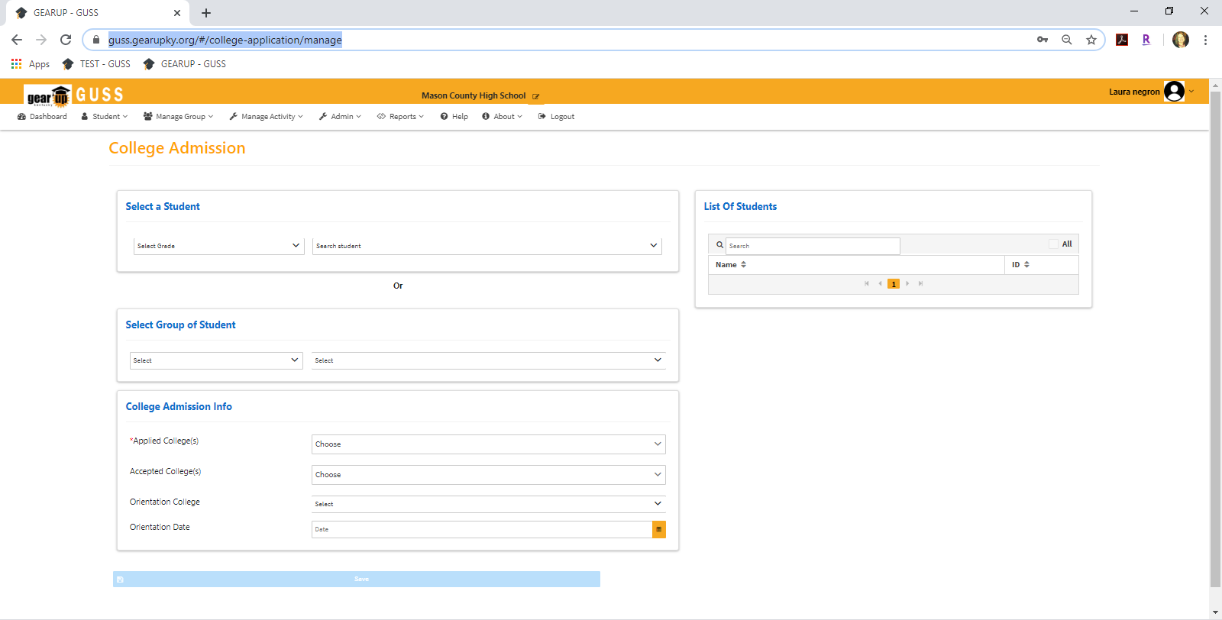
GUSS NEW FEATURE TRAINING – COLLEGE ADMISSION PAGE
You may enter College Admission data by individual student or by group. You can select more than one student at a time using the individual student function.
Select the grade and either the name of the student OR the name of the group.
  If you are selecting an individual student, the student list will automatically populate in the Search Student drop down once you’ve selected the grade (Red arrow below). Once you select a student’s name, their name will automatically populate in the List of Students (Green arrow below). Please NOTE that the system will only allow you to enter 12th grade students for this function.
  If you are selecting a group, the student names will populate under List of Students (Green arrow below). You can then select All by using the All box or select individual students within the group.

Slide 5
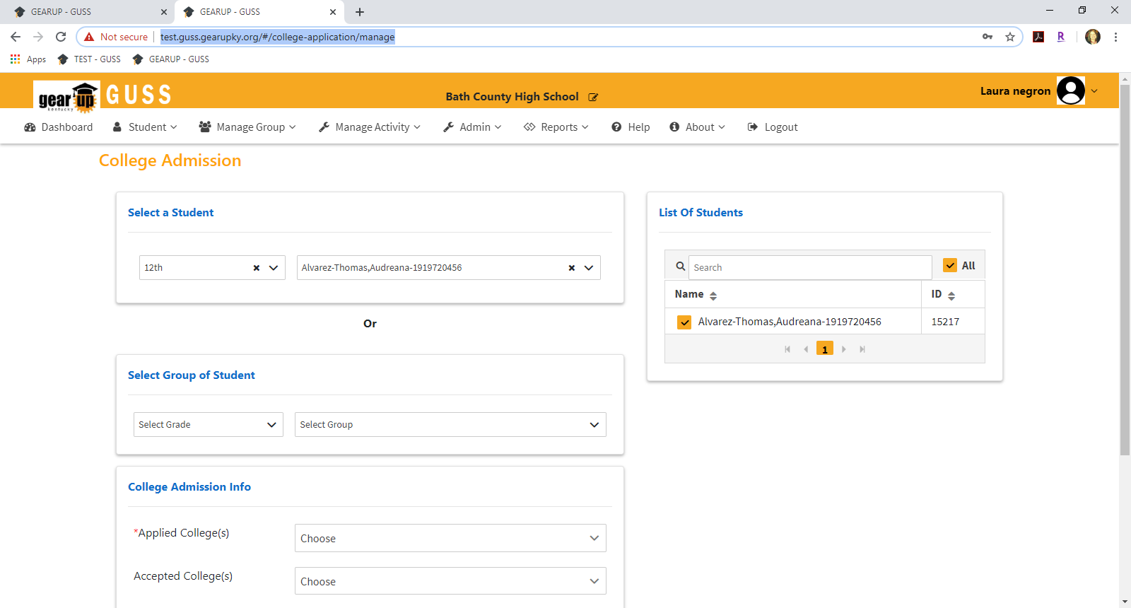
GUSS NEW FEATURE TRAINING – COLLEGE ADMISSION PAGE
4. Select the student(s) name(s) from the List of Students.
NOTE: There are 2 required areas of this form. One is the student selection in the List of Students. The other is the Applied College(s) dropdown.

Slide 6
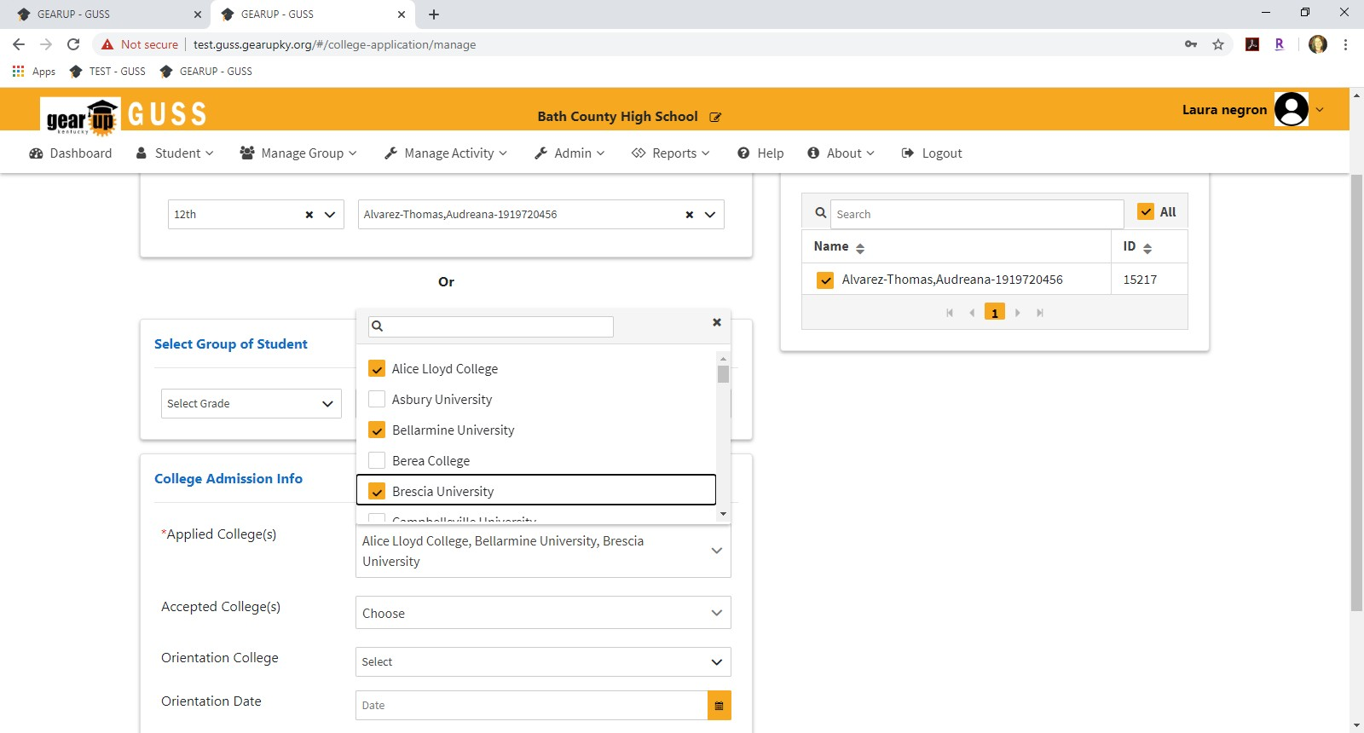
GUSS NEW FEATURE TRAINING – COLLEGE ADMISSION PAGE
5. Use the dropdown menu to Select the college(s) to which the student applied. This can be 1 or multiple selections. This field is required.

Slide 7
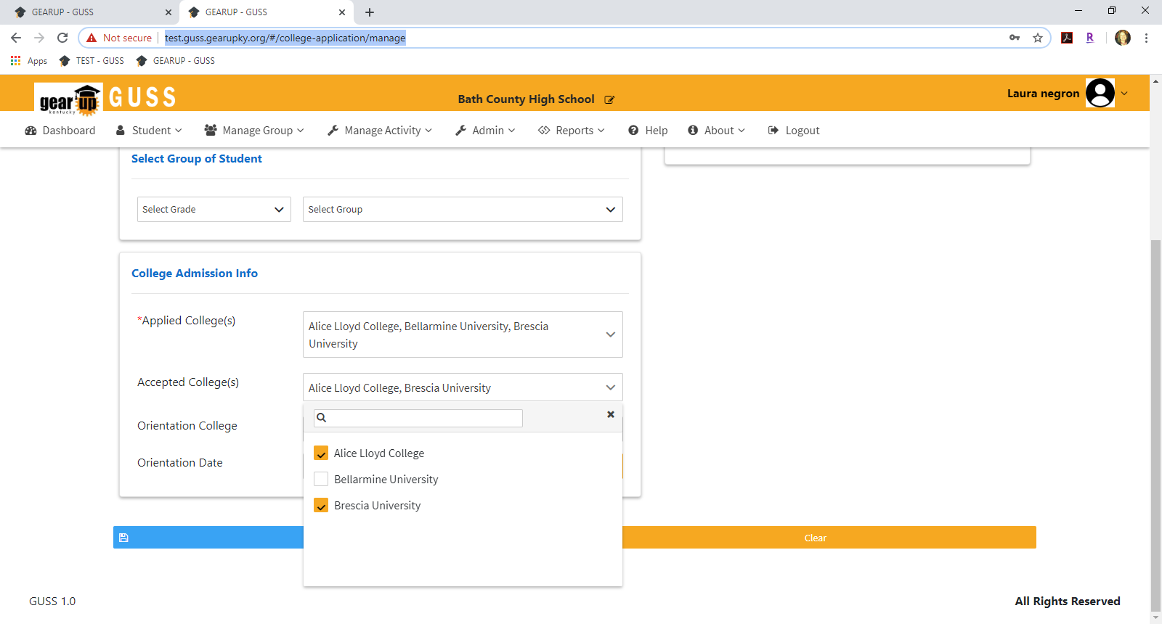
GUSS NEW FEATURE TRAINING – COLLEGE ADMISSION PAGE
6. Use the dropdown menu to Select the colleges to which the student was accepted. NOTE: Only colleges selected in the Applied Colleges dropdown will populate in the Accepted Colleges dropdown.

Slide 8
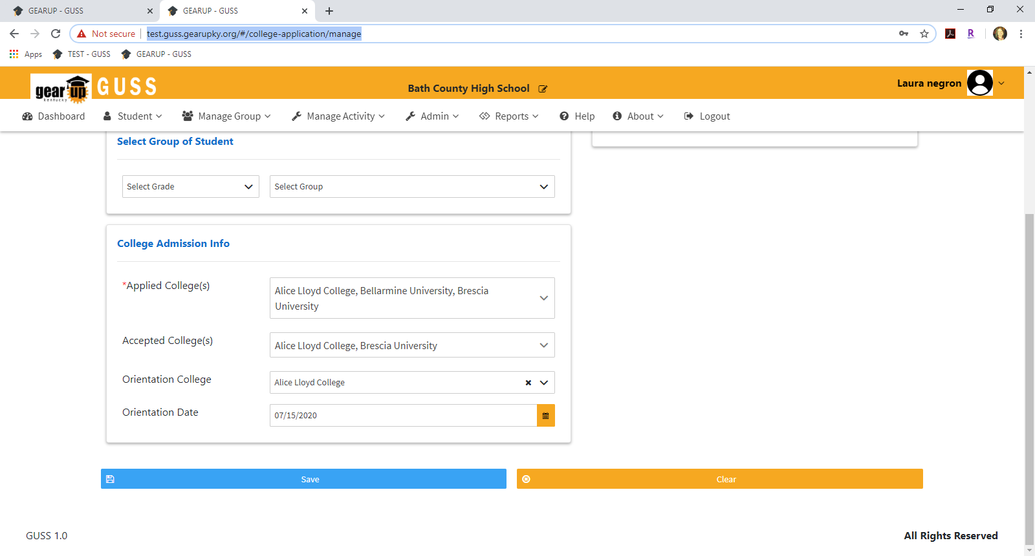
GUSS NEW FEATURE TRAINING – COLLEGE ADMISSION PAGE
Enter the Orientation College (this should be the college the student plans to attend) and the date of the orientation.
Select Save. NOTE: You cannot Select Save until you have entered at LEAST the Applied Colleges and Selected the student(s) name(s) in the List of Students.

Slide 9
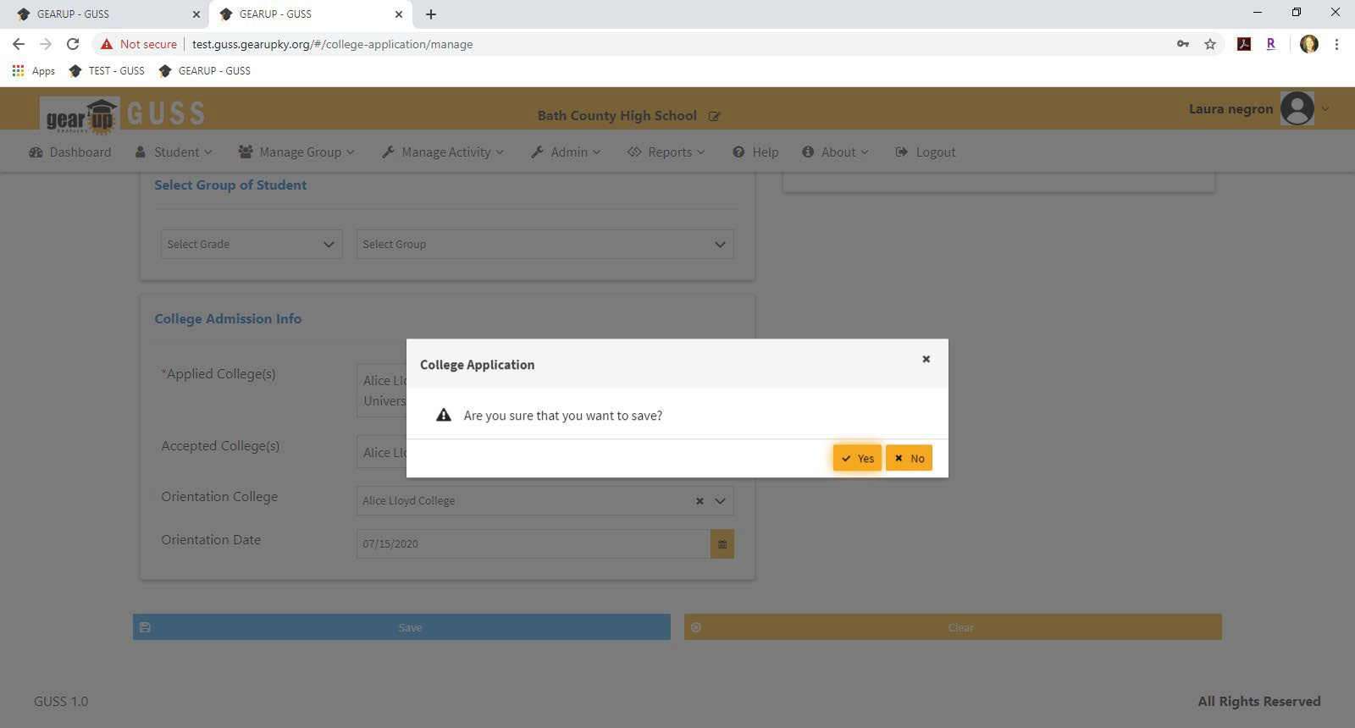
GUSS NEW FEATURE TRAINING – COLLEGE ADMISSION PAGE
9. Select Yes. A blank form will appear on the screen.
NOTE: Once the record is submitted, it cannot be edited.

Slide 10
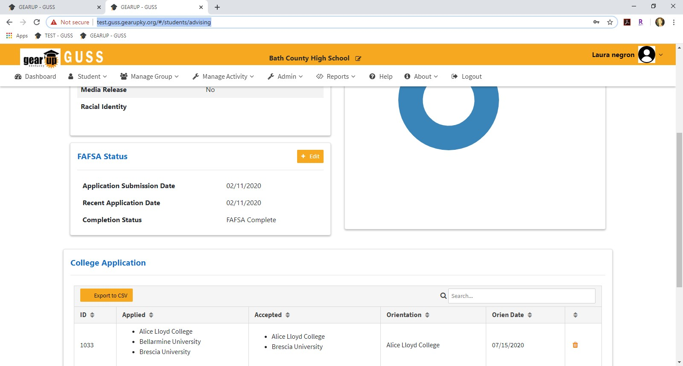
GUSS NEW FEATURE TRAINING – COLLEGE ADMISSION PAGE
10. College Application information will now appear in the Student Advising page.

Slide 11
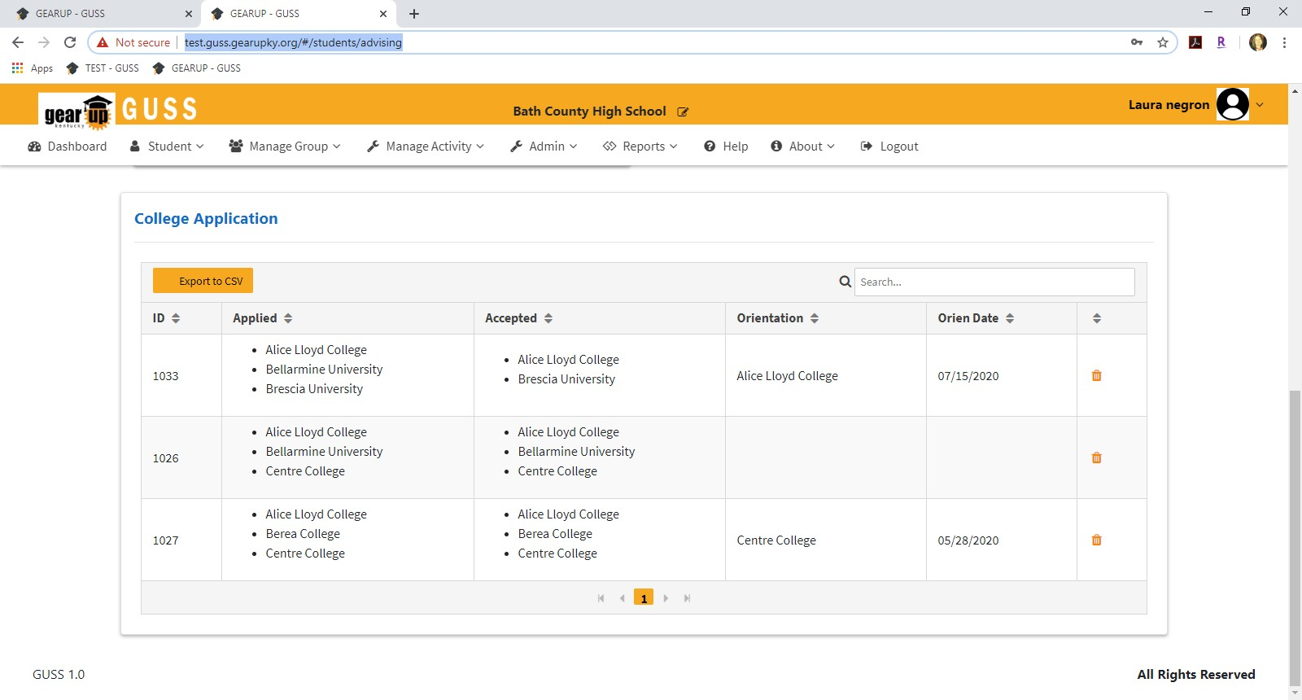
GUSS NEW FEATURE TRAINING – COLLEGE ADMISSION PAGE
NOTE: There is currently no Edit or Delete functionality for the College Application page. This means that if you create a record before you know the college the student accepts or the orientation date and want to go back and add that information, you will need to create a new record with the complete application information. This will create an entirely new record.

