Slide 1
Managing Groups in guss
Creating & editing

Slide 2
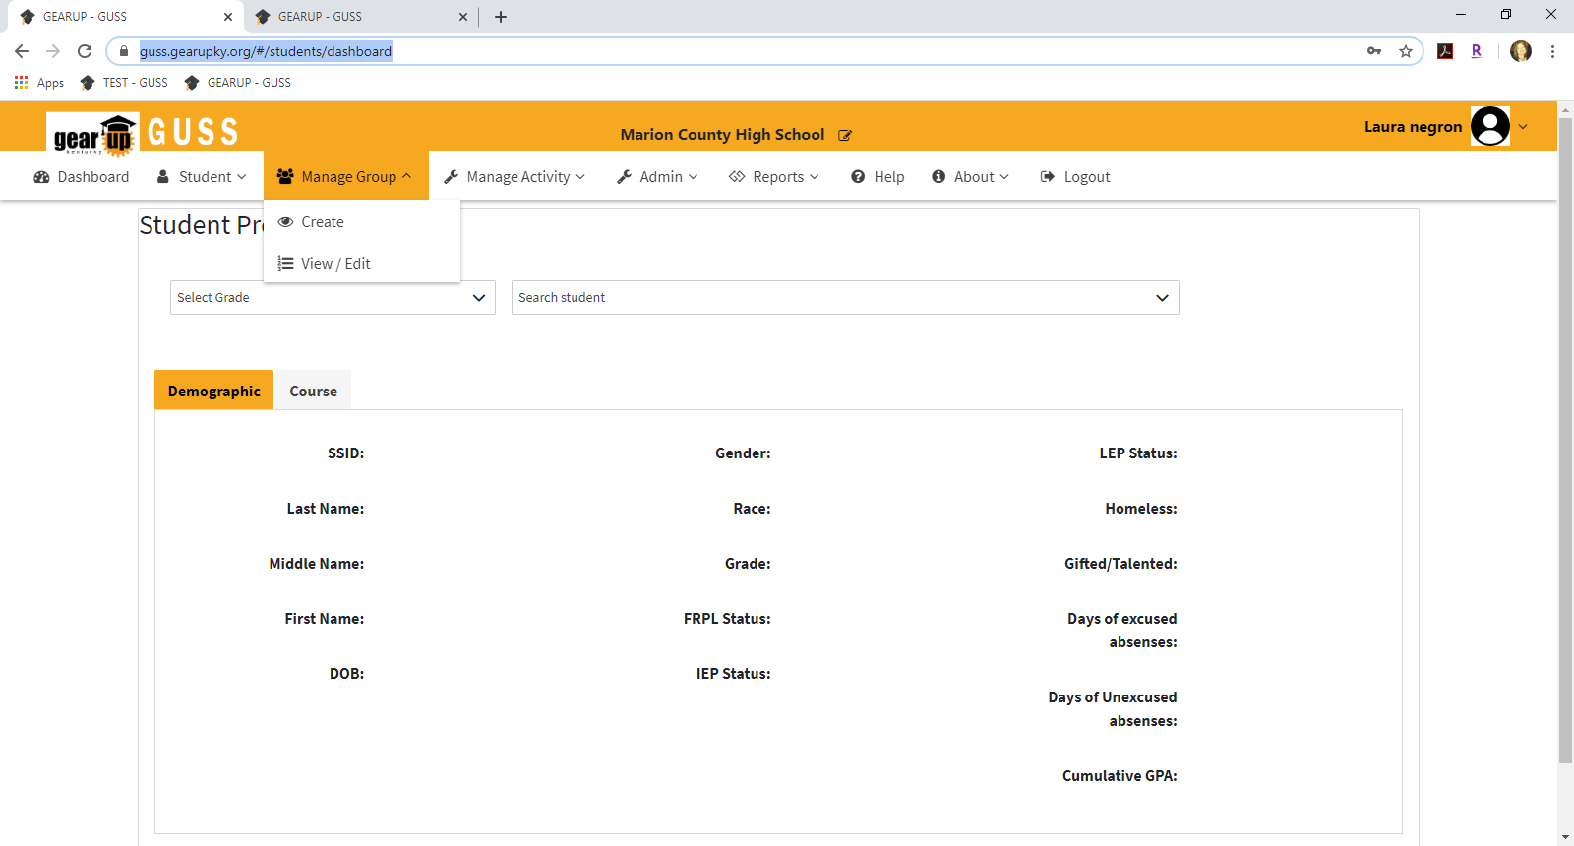
GUSS TRAINING – MANAGING GROUPS – CREATING & EDITING
Log into GUSS.
Select the Manage Group tab. You will see 2 options – Create and View/Edit
2

Slide 3
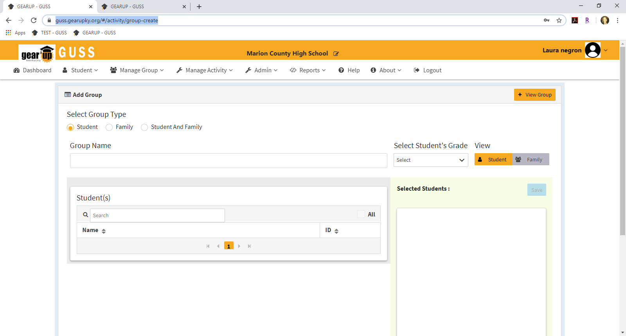
GUSS TRAINING – MANAGING GROUPS – CREATING & EDITING
Create Group
There are three options for group creation – Student, Family, or Student and Family.
  Students groups are the only groups you should be creating at this time. Once we have Family page functionality, you will be able to utilize the other options.
  Select Student Group.
3

Slide 4
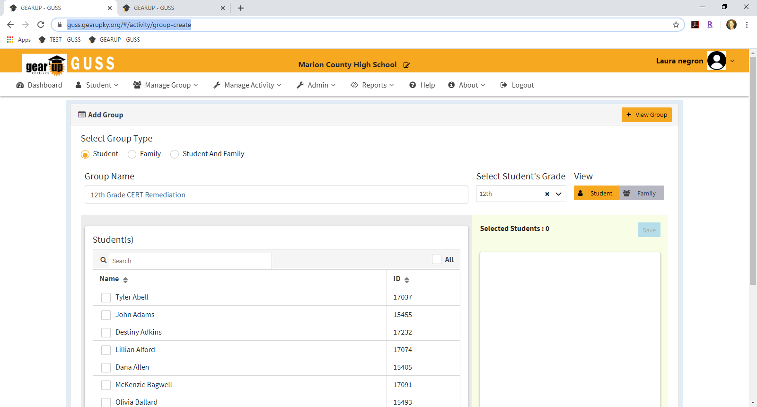
GUSS TRAINING – MANAGING GROUPS – CREATING & EDITING
Student Group
Enter a Group Name. This can be anything you choose, but should be descriptive and unique (Red arrow).
Select Student’s Grade (Green arrow).
  Once you select a grade, the system will self-populate the students from that grade level into the Student selection box (Blue arrow).
4

Slide 5
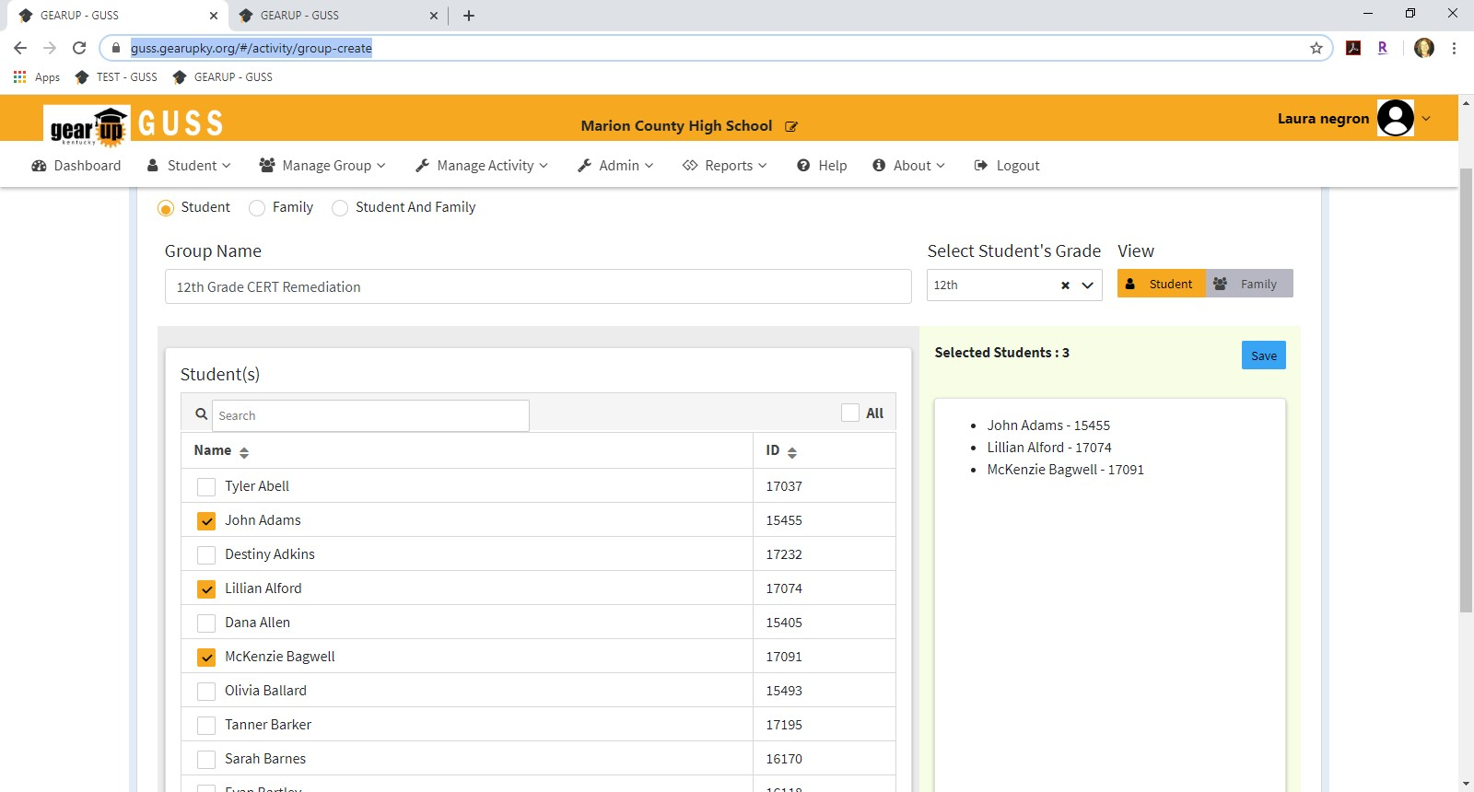
GUSS TRAINING – MANAGING GROUPS – CREATING & EDITING
As you select students, they will appear in the Selected Students box (Red arrow)
Once you have selected all of the students, Select Save (Green arrow)
o You CAN edit groups once they are created.
5

Slide 6
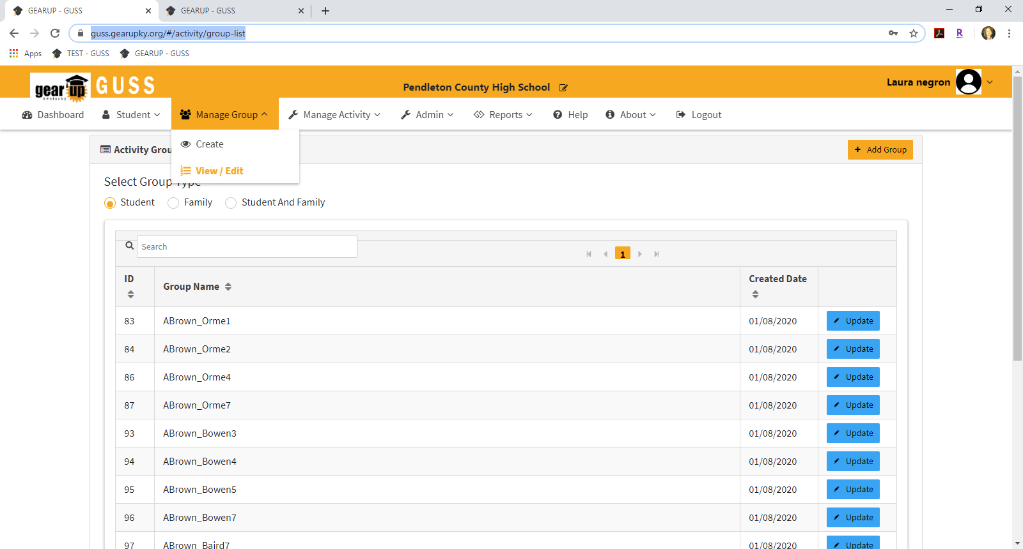
GUSS TRAINING – MANAGING GROUPS – CREATING & EDITING
Edit Groups
Select View/Edit from the Manage Group tab (Red arrow).
Select the Update button for the group you’d like to edit (Green arrow).
6

Slide 7
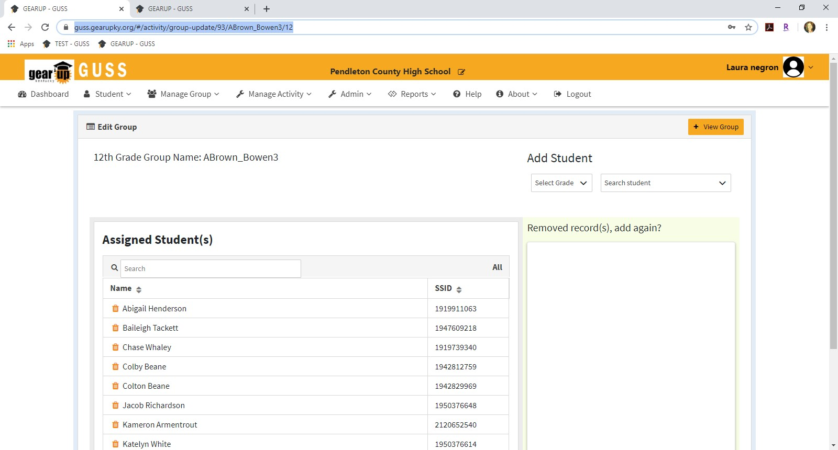
GUSS TRAINING – MANAGING GROUPS – CREATING & EDITING
From this Edit Group page, you can delete students from the group (Red arrow) or add students (Green arrow).
7

Slide 8
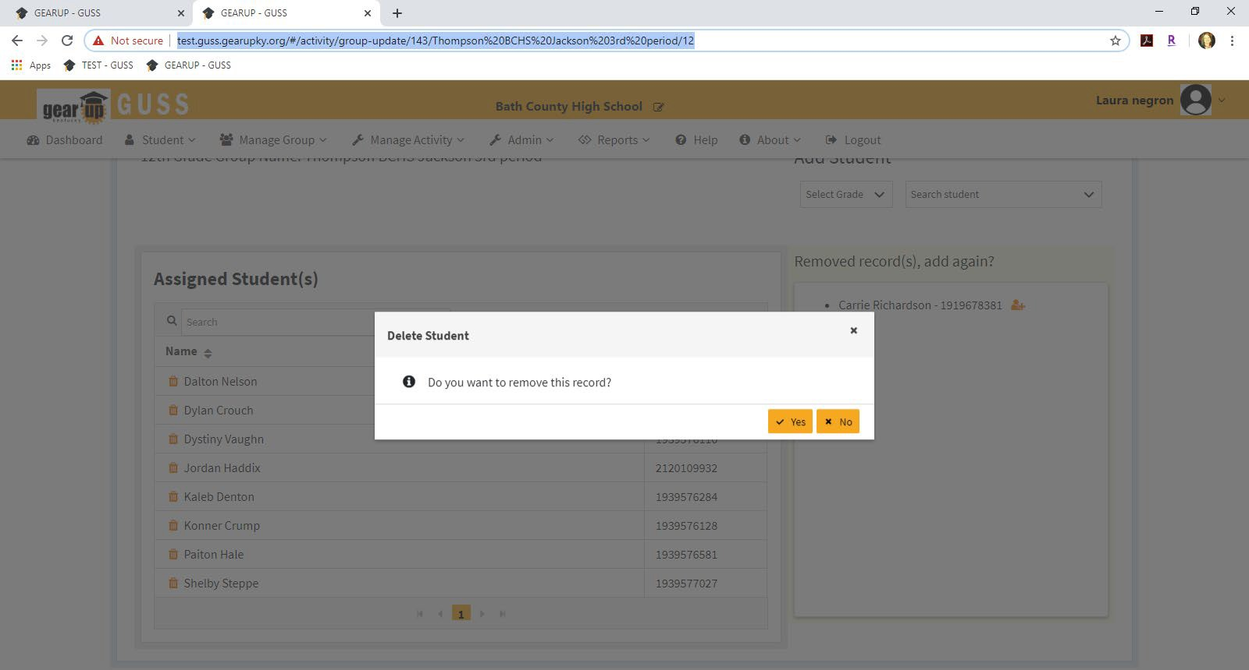
GUSS TRAINING – MANAGING GROUPS – CREATING & EDITING
You will be prompted to certify that you are sure you want to remove the record (Red arrow) AND removed records can be added back until you leave the screen (Green arrow).
The Edit Group function for Family and Family & Student groups is still in production
8

